Slide 1
Arkwright Interview
Clement Jin

Slide 2
The Problem with Alarm Clocks…
The Problem
Design Requirements
Sound is jarring and disruptive.
Relies on a good sense of hearing.
Lift the curtain
At a specified time
My Solution
Sunlight!
Physiological benefits.
Notes:
30s
Research has shown sunlight is a more natural and comfortable way of being woken up.
Physiological effects making you more alert and awake.

Slide 3
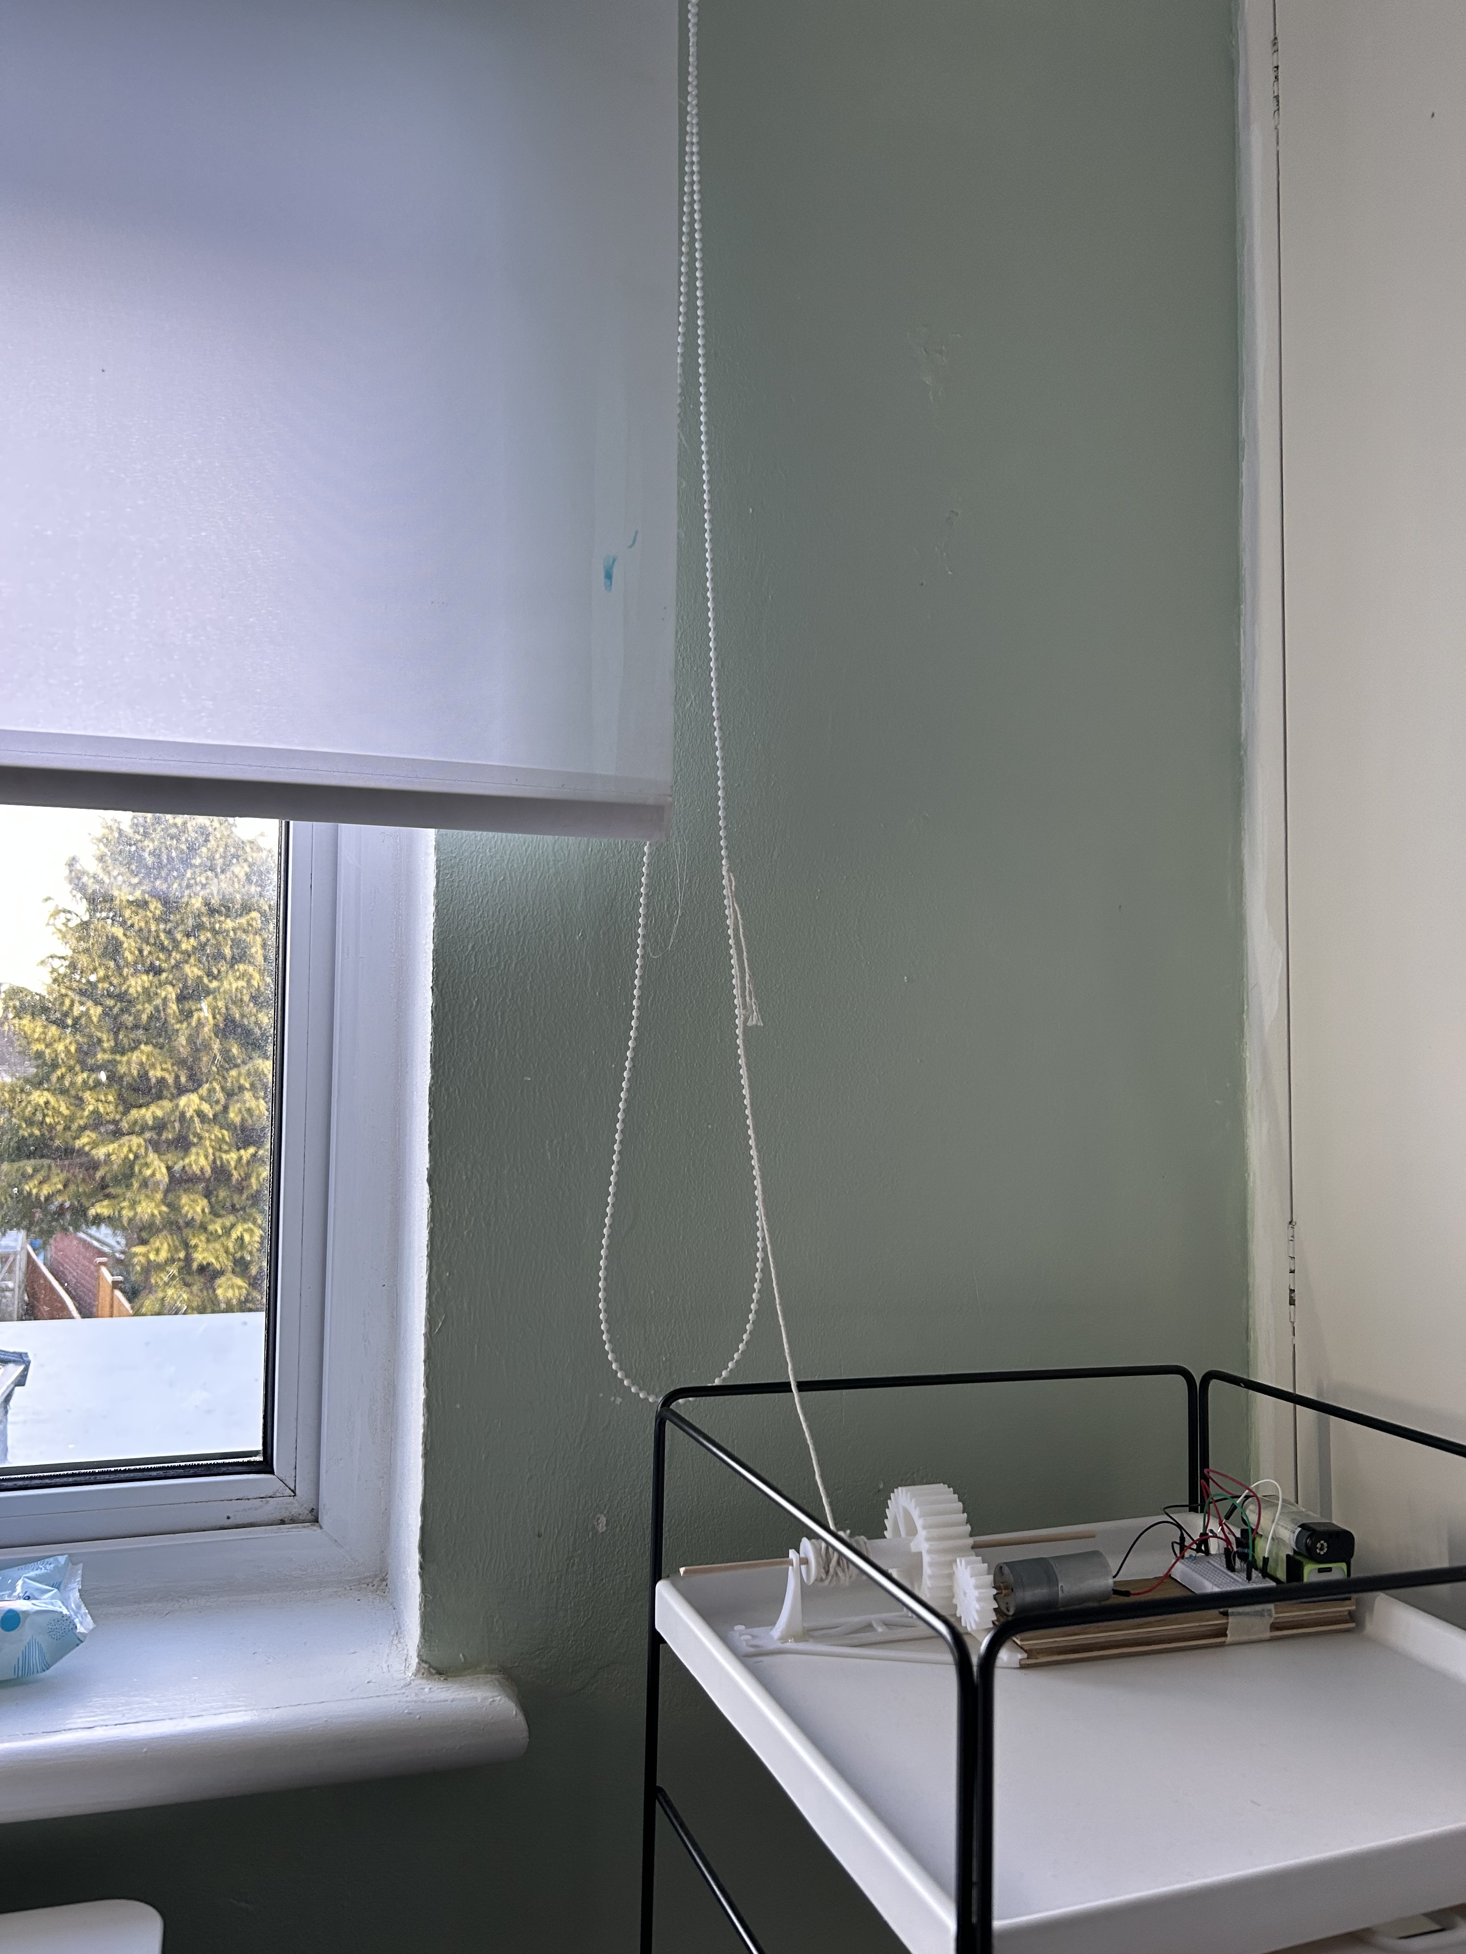
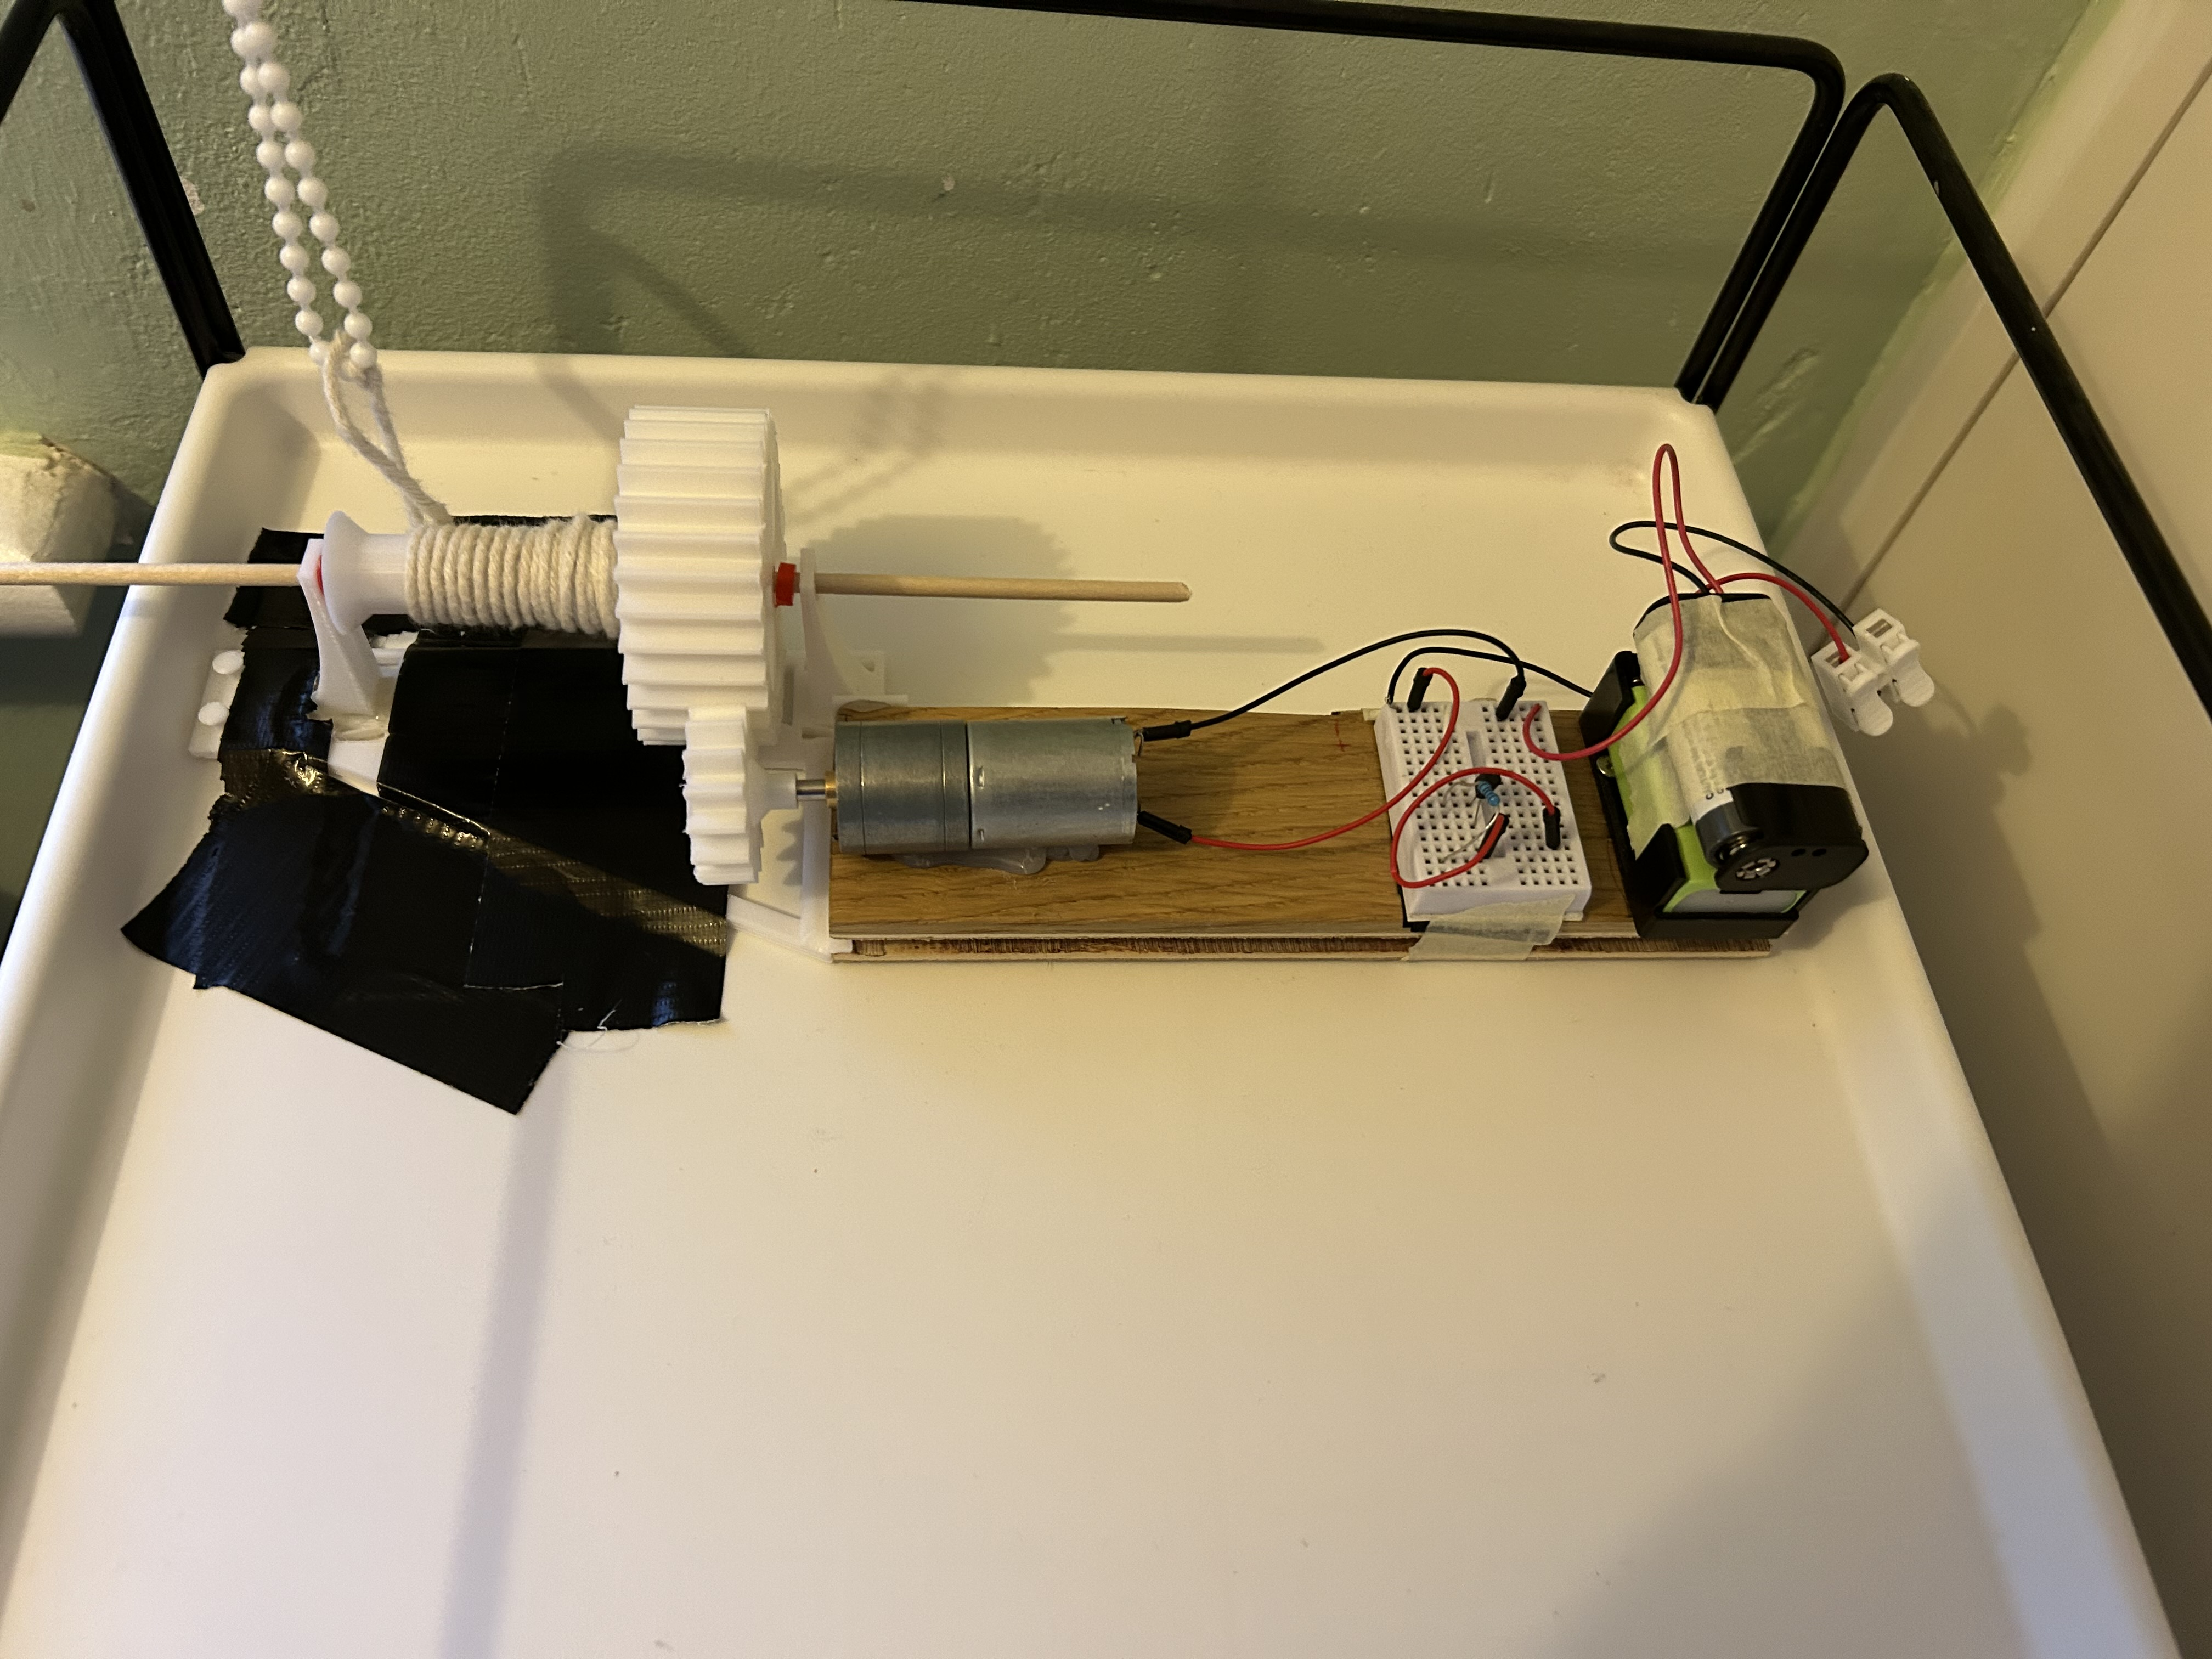
Lifting the Curtain
Required very high torque
High torque motor was insufficient
Custom 3D printed Gear train
Notes:
40s
Attach a string to the vertical curtain. Wound round a shaft by a motor.
Gears ultimately provided enough torque.
3D printing great - precise design specific to my needs.
(Alarm pulled up instead of pulling curtain down. Duct tape as a temporary solution. )

Slide 4
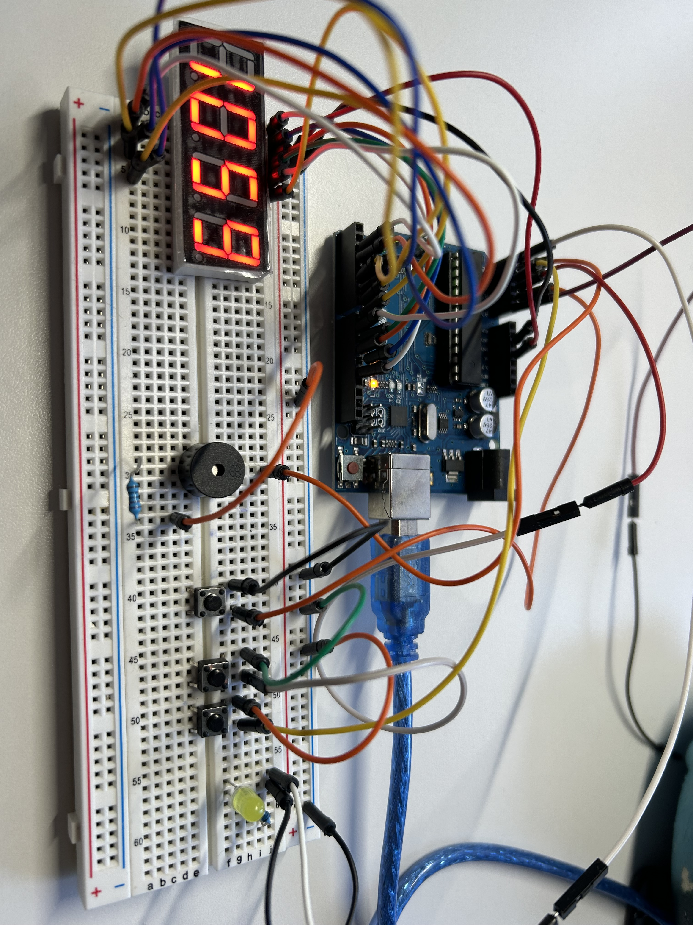
Keeping Time
3-button UI
Modular code: Splitting into files
Display flickered excessively.
Open-source library
Code structure made this easy to implement.
Notes:
50s
Tried to keep things simple. Arduino, 7-segment display. Buttons to display & edit current/alarm time
Splitting into files for organization and readability. Ultimately proved wise.
The display part of my code caused digits to flicker excessively. Used an open-source library to display digits for me. A matter of swapping one function for another, while keeping all the other code the same.
-------------------------------------
(I can now explain how the open-source code changes the display!)
This takes up a lot of space
Files were display, clock, UI, alarm

Slide 5
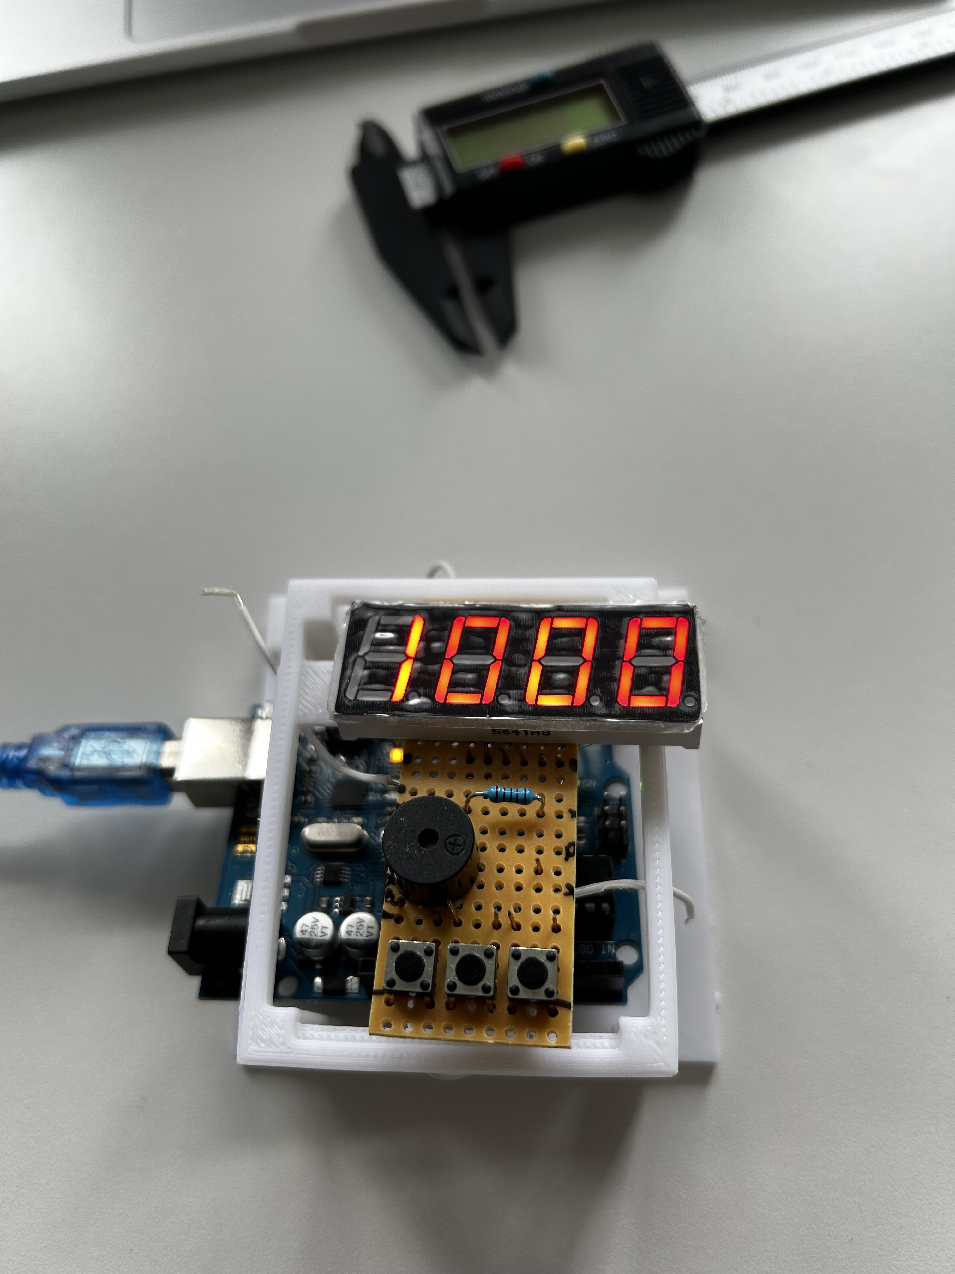
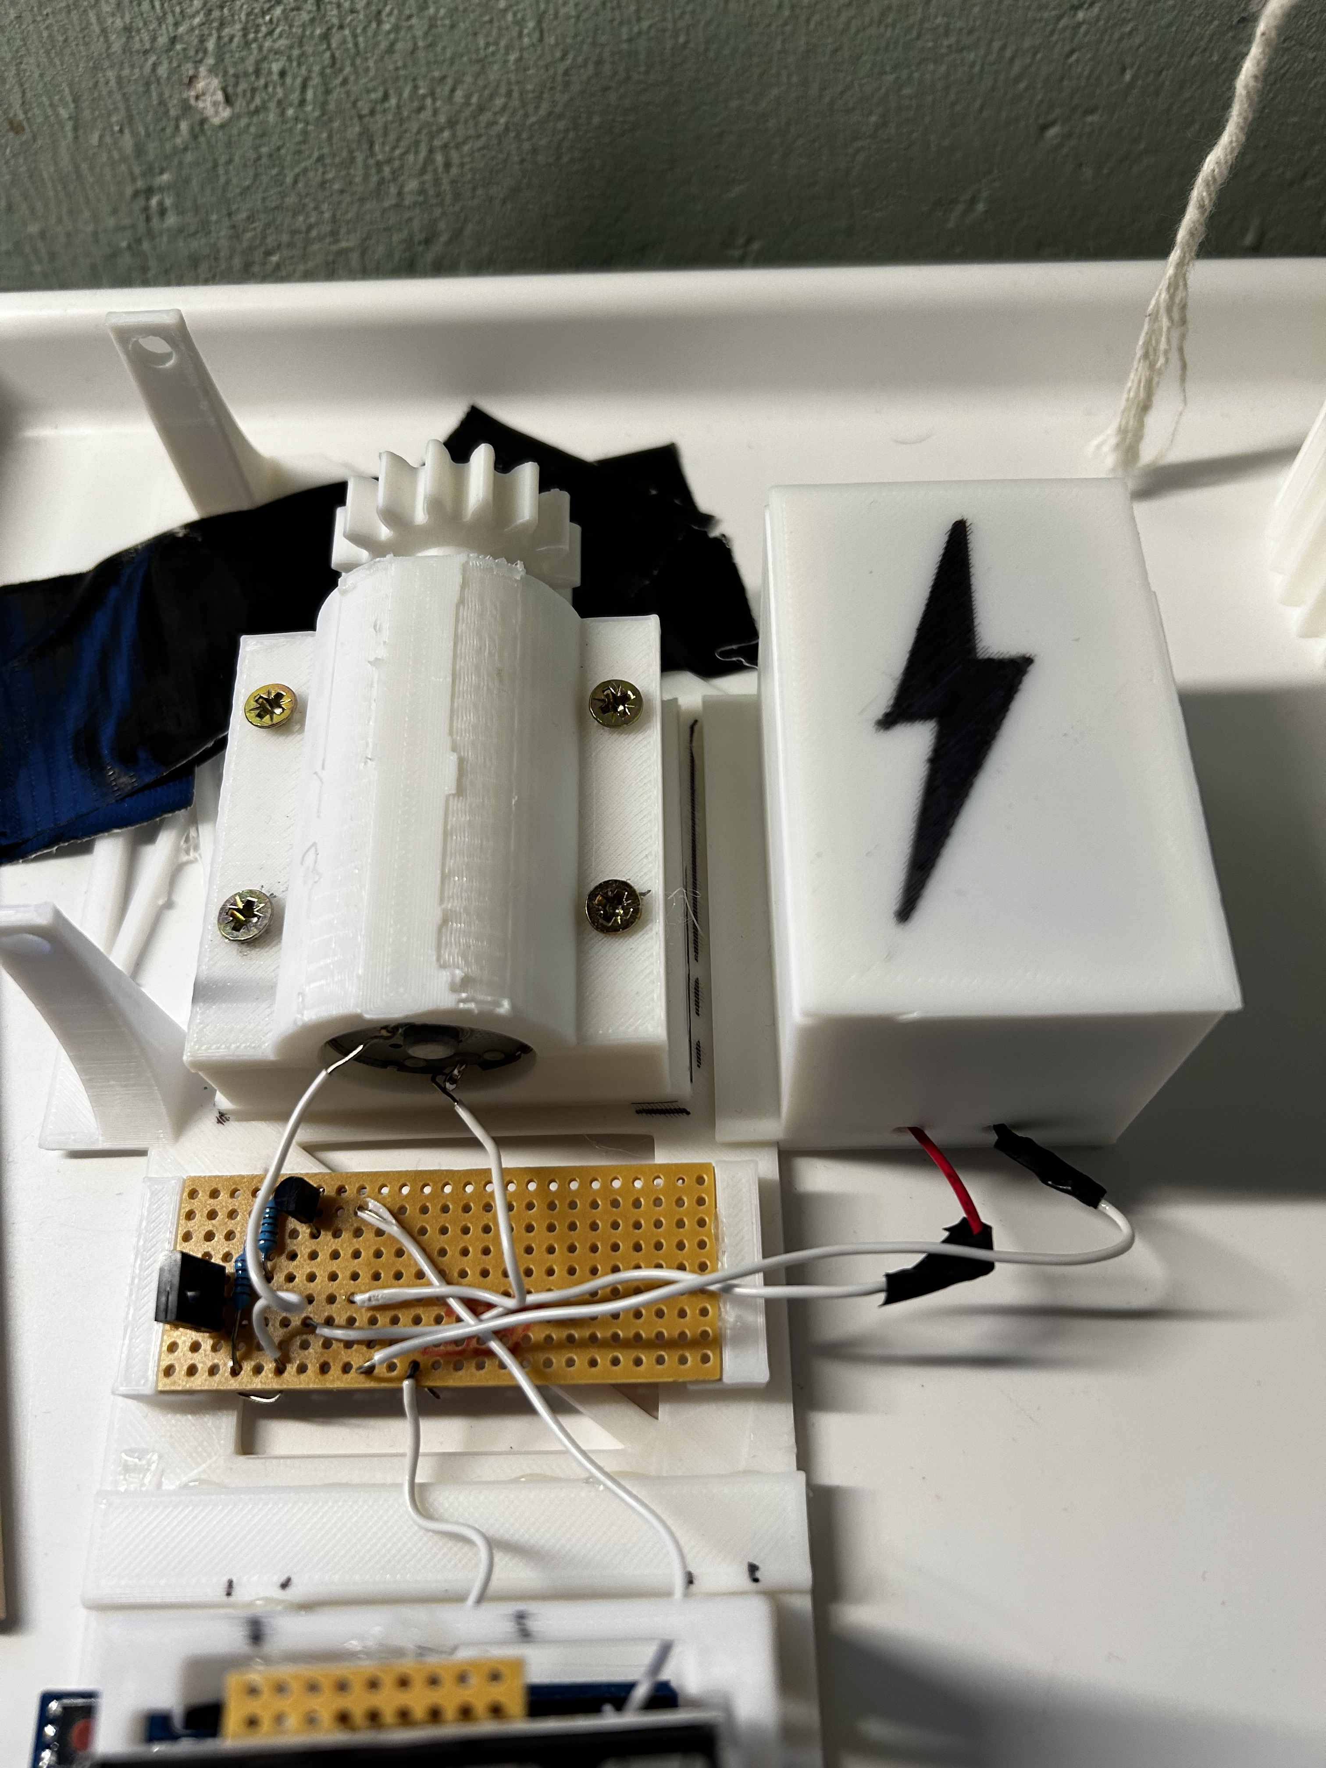
Progression: Reducing Footprint
Soldering on stripboard
More compact and reliable
3D printed housing
Alarm is now 1 unit
Notes:
30s
The main point of improvement was
Soldering:
More compact and reliable (better electrical connections) than a breadboard.
Greater wire management (display not blocked by wires)
Housing
Housing made the alarm 1 unit instead of a collection of loose, individual parts.
More efficient use of space

Slide 6
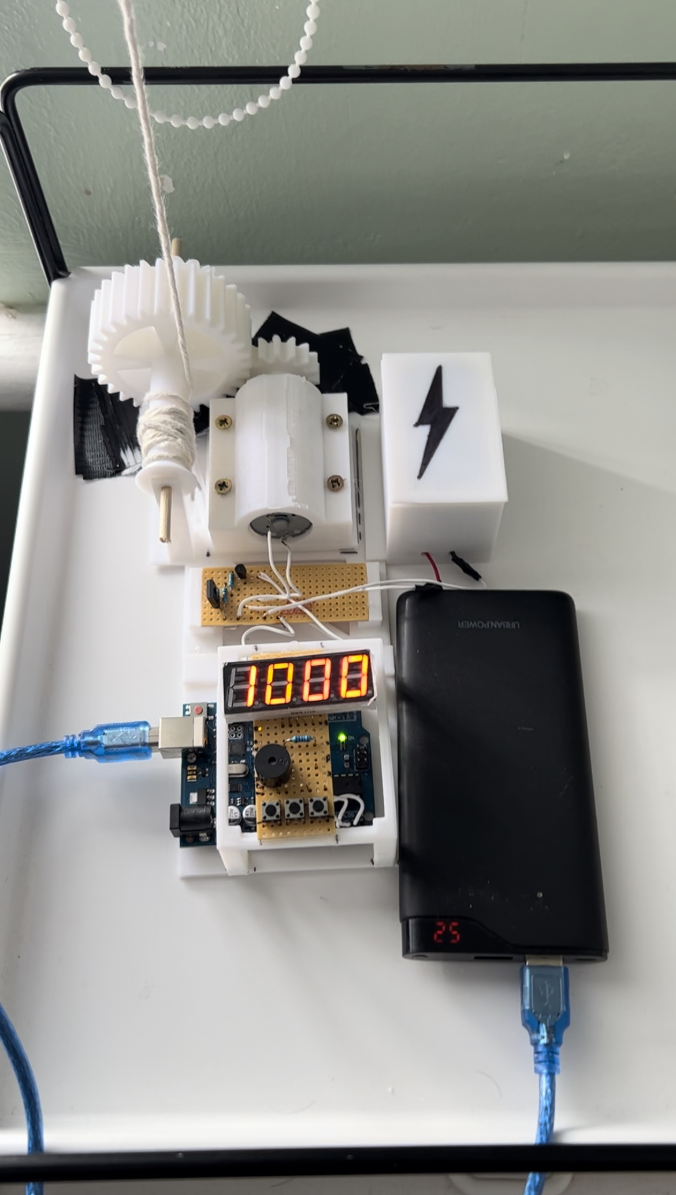
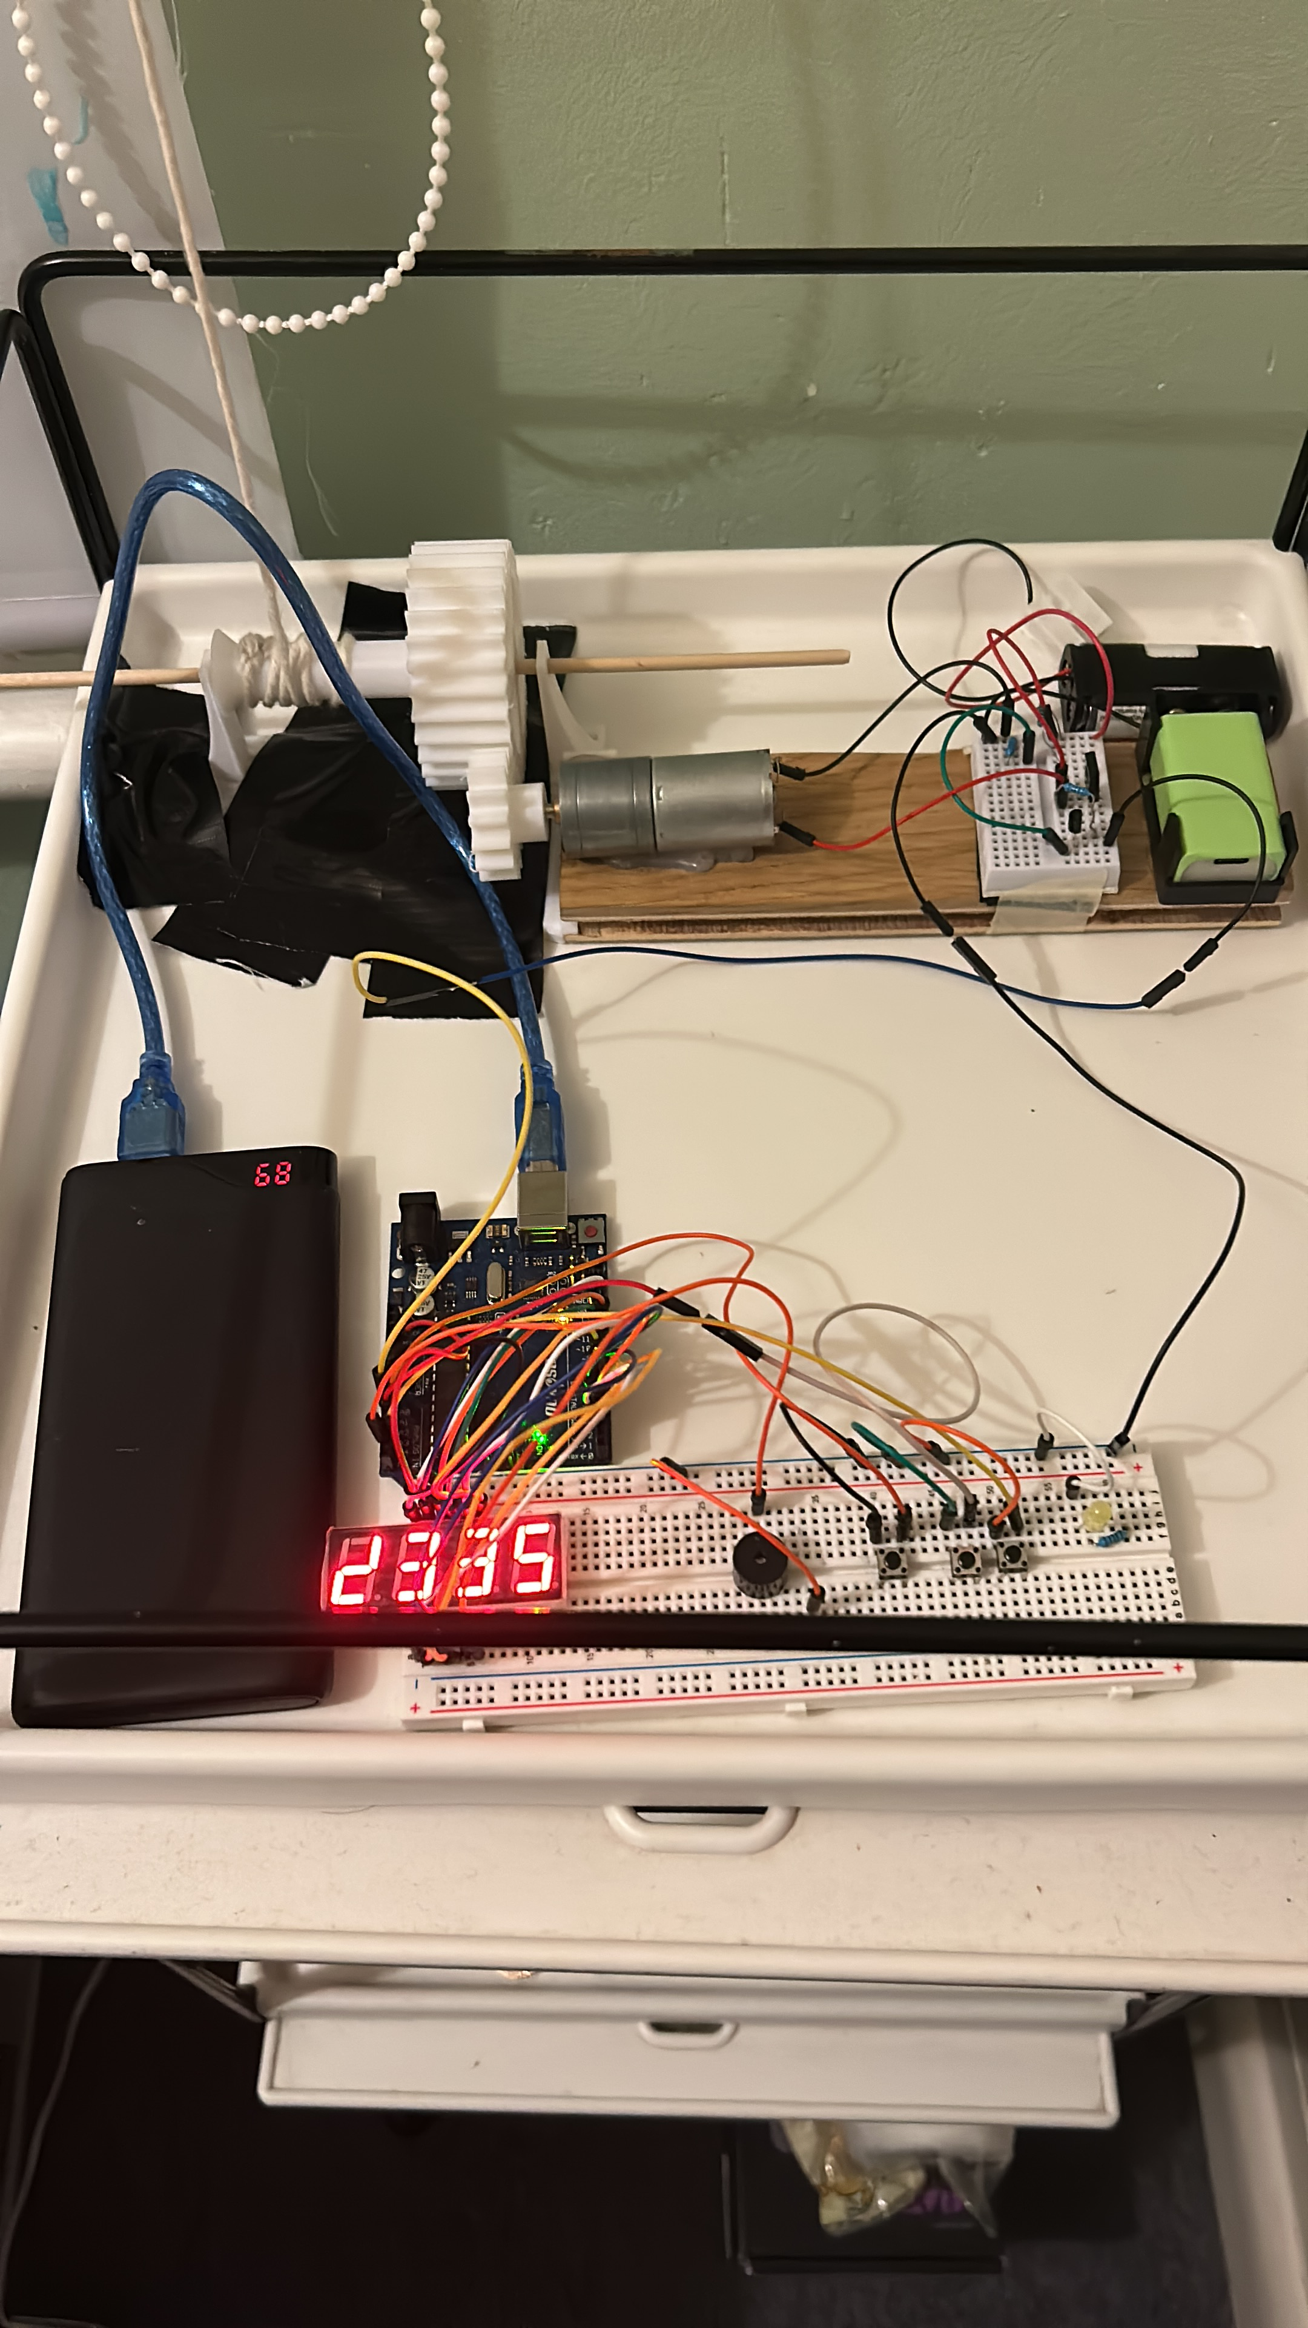
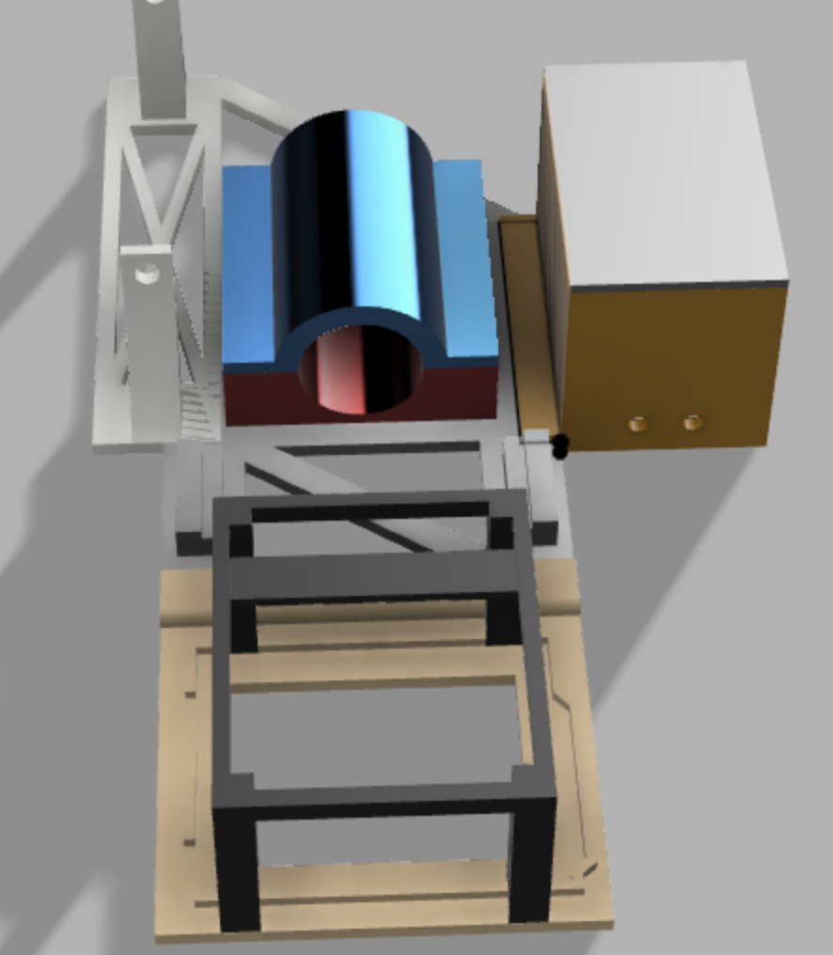
3D Design
Precise designs at small scale
Modular structure
Notes:
35s
Chose to 3d print.
Accurate at small scales
Wood -> difficult to work with at that size and thickness combined with the complexity of the shapes. No access to a laser cutter.
After putting it all together, my build looked almost identical to the CAD model
Modular Design, Like the code
Kept individual components separate in CAD (different colours) so I could iterate though and reprint just the relevant sections.
Notes (in case of questions)
Plastic did prove strong enough.
If not, increasing thickness or increasing infill would improve strength, e.g. on the large gear and motor holder.

Slide 7
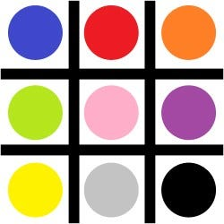
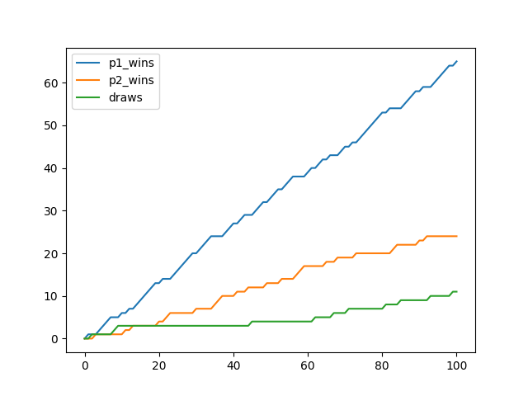
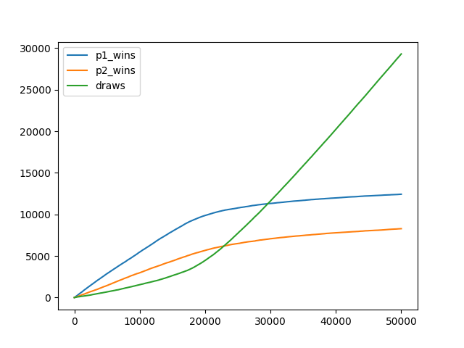
Wider Interests
EduSpots Charity Club
STEM Journal Club
Matchbox AI
Noughts and Crosses
Notes:
50s
EduSpots is a club that works with the Charity EduSpots. Developing STEM projects for around 50 education “spots” in Ghana.
I focused on creating a website to centralized media across spots.
Talks by students, teachers, visitors. I gave one on increasing the efficiency of solar panels.
A field that really interests me is AI. I sought to create a simple reinforcement learning algorithm to play Noughts and Crosses. Perfect strategy found.

